Slide 1
DATA MINING 4. Algoritme k-Nearest Neighbor
Joko Suntoro
jokosuntoro@usm.ac.id
SMS/Telp: 082242369670
WA/Telegram: 085641970170
http://jokosuntoro.com

Slide 2

Joko Suntoro
SDN Pandean Lamper 03 Semarang (2001)
SMPN 32 Semarang (2004)
SMA Institut Indonesia Semarang (2007)
S1 Teknik Informatika Universitas Semarang (2010-2015)
S2 Teknik Informatika Universitas Dian Nuswantoro (2015-2016)
Tim Operasi dan Teknik, Domestic Gas PT Pertamina (Persero) (2008-sekarang)
Bidang Penelitian: Data Mining, Intelligent System dan Machine Learning
Peneliti dan Reviewer di Romi Satria Wahono (RSW) Intelligent System Research Group

Slide 3
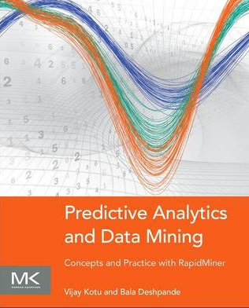
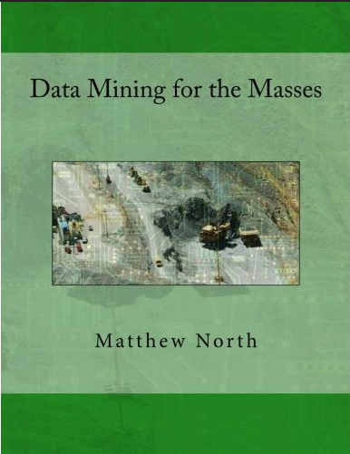
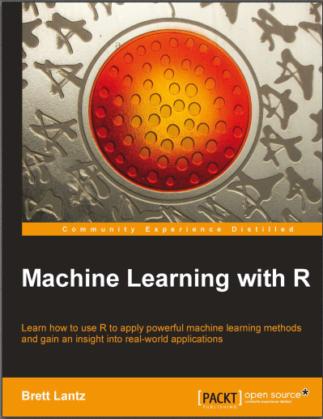
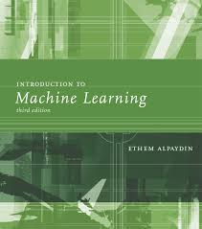
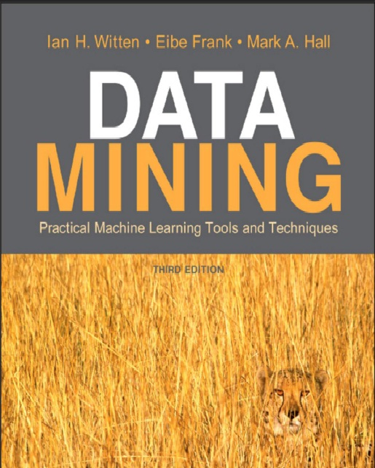
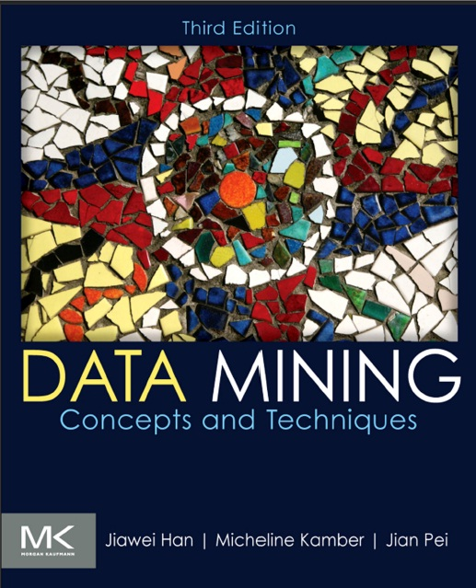
Textbooks

Slide 4
4.1 Introduction to k-NN Algorithm

Slide 5
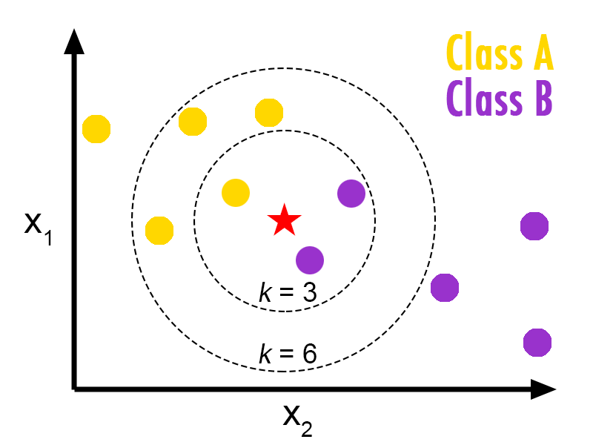
Konsep Algoritme k-Nearest Neighbor (k-NN)

Slide 6
Definisi Algoritme k-NN
k-NN mengidentifikasi nilai “k” dalam data pelatihan yang merupakan “tetangga terdekat” (Lantz, 2013)
Metode untuk melakukan klasifikasi terhadap objek berdasarkan pembelajaran yang jaraknya paling dekat dengan objek tersebut

Slide 7
Langkah-Langkah Algoritme k-NN
1. Tentukan data testing dan nilai parameter k
3. Urutkan data berdasarkan jarak terkecil
2. Hitung jarak antara data testing dan data training
4. Kelompokkan data

Slide 8

Penghitungan Jarak Antar Data
Euclidean Distance
$$Ed\left(x,y\right)= \sqrt{\sum_{i=1}^{n}{{(x_{i}−y_{i})}^{2}}}$$
Manhattan Distance
$$Md\left(x,y\right)=\sum_{i=1}^{n}{|x_{i}−y_{i}|}$$
Notes:
Mahalanobis
Minkowski

Slide 9
Studi Kasus Algoritme k-NN

Slide 10
Dataset yang Digunakan

Slide 11
Data Training
Outlook | Temperature | Humidity | Wind | Play
Sunny | 85 | 85 | false | no
Sunny | 80 | 90 | true | no
Overcast | 83 | 78 | false | yes
Rain | 70 | 96 | false | yes
Rain | 68 | 80 | false | yes
Rain | 65 | 70 | true | no
Overcast | 64 | 65 | true | yes
Sunny | 72 | 95 | false | no
Sunny | 69 | 70 | false | yes
Rain | 75 | 80 | false | yes
Sunny | 75 | 70 | true | yes
Overcast | 72 | 90 | true | yes
Overcast | 81 | 75 | false | yes
Rain | 71 | 80 | true | no

Slide 12
Data Testing
Outlook | Temperature | Humidity | Wind | Play
Rain | 77 | 75 | false | ?
Overcast | 60 | 95 | True | ?

Slide 13
Pengolahan Data Awal (Preprocessing Data)

Slide 14
Data Transformation (Discretization)
Atribut Outlook
Atribut Wind
Sebelum preprocessing | Setelah Preprocessing
Overcast | 1
Rain | 2
Sunny | 3
Sebelum preprocessing | Setelah Preprocessing
false | 0
true | 1

Slide 15
Referensi
Bache, K., & Lichman, M. (2013). UCI Machine Learning Repository. Retrieved from http://www.ics.uci.edu/~mlearn/MLRepository.html
Ethem Alpaydin. Introduction to Machine Learning. 3rd ed. MIT Press. 2014
Harrington, P. (2012). Machine Learning in Action. United States of America: Manning Publications Co.
Hofmann, M., & Klinkenberg, R. (2013). Rapid Miner Data Mining Use Cases and Business Analytics Applications. CRC Press Taylor & Francis Group
Ian H. Witten, Frank Eibe, Mark A. Hall. Data mining: Practical Machine Learning Tools and Techniques 3rd Edition. Elsevier. 2011
Jiawei Han and Micheline Kamber. Data Mining: Concepts and Techniques Third Edition. Elsevier. 2012
Lantz, Brett. Machine Learning with R. Packt Publishing. 2013
Larose, D. T. (2006). Data Mining Methods and Models. Data Mining Methods and Models. Canada: Willey Publishing, Inc.
Noth, Matthew. Data Mining for The Masses. Creative Commons Attribution. 2012
V. Kotu, Predictive analytics and data mining. USA: Elsevier Inc., 2015.
Wahono, R. S. (2016). Computing Courses Data Mining. Retrieved from http://romisatriawahono.net/dm/

